Slide 1


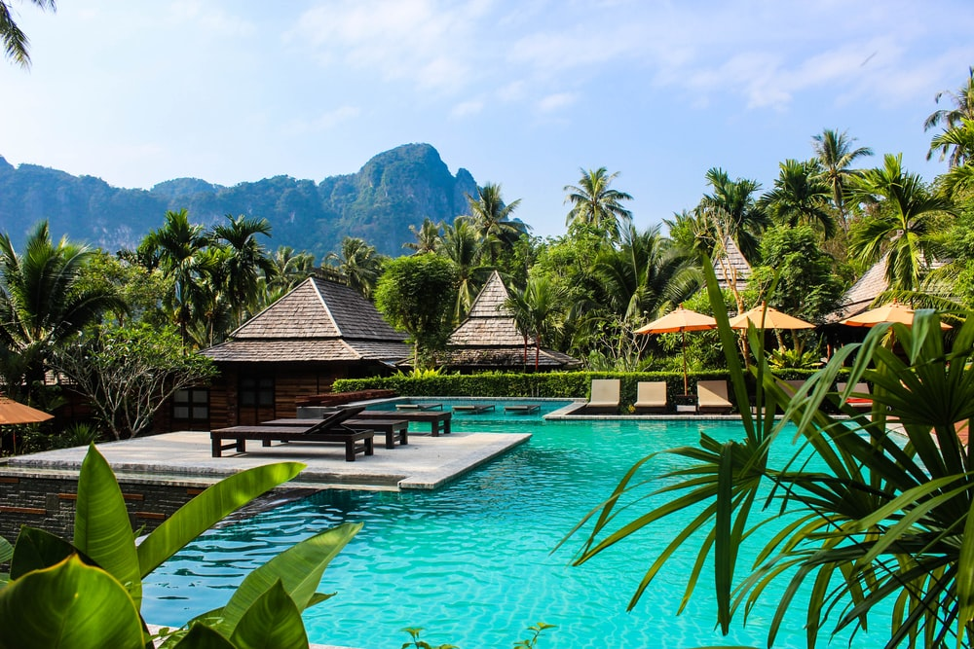


Hotel
Management
System

Slide 2





Hotel Sky Dragons
WD_B04_ITP_03

Slide 3
INTRODUCTION
“Sky Dragons” is a Hotel that has recently been started by few veterans in the industry with high demand.

Slide 4





PROBLEM STATEMENT
Higher time consumption when storing data related to the customer, employee and supplier details
Customer feedbacks cannot be collected
Customers cannot get a better understanding about the facilities
Staff does manual entry for visitors which is extremely difficult to manage at peak times or vacation periods
The reservation system in this hotel is done over the phone. It takes more time and costs more money

Slide 5




SOLUTIONS
Developing an automated hotel management system instead of manual system
Maintaining databases to store data and keep updated
Doing all the calculations and analysis from the system
Providing user friendly platform to connect with the customers

Slide 6



BENIFITS
Increase the reliability and the productivity
Task completion time will be reduced
Can significantly enhance the customer satisfaction
Can obtain a competitive advantage over rivals
Easy to access the system from anywhere through any device

Slide 7





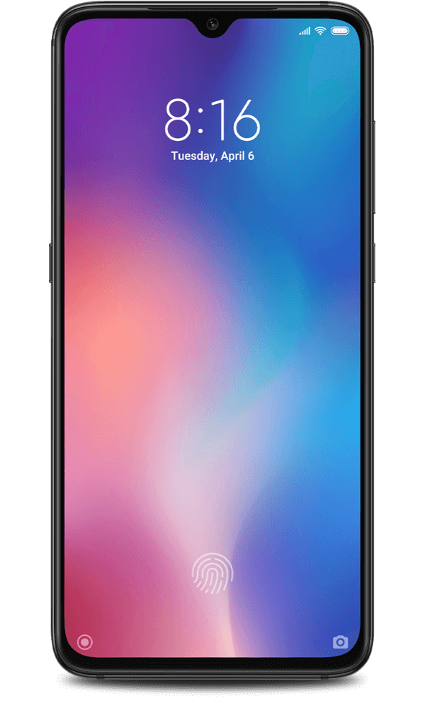

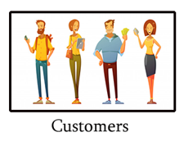
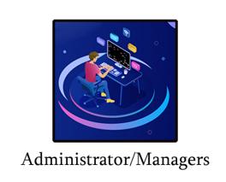


SYSTEM OVERVIEW
User Interface
User
Web Server
Suppliers
Application Server
Feedback DB
Customer DB
Reservation DB
Finance DB
Extra-facility DB
Employee DB
Supplier DB
Restaurant DB

Slide 8
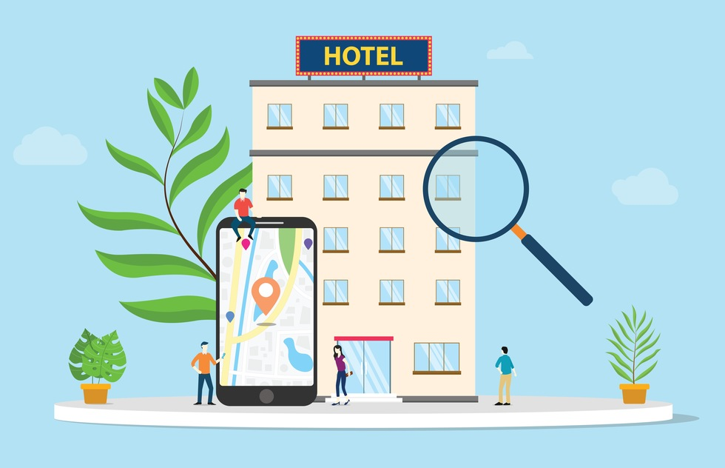
FUNCTIONS
Reservation management
Restaurant management
Employee management
Feedback management
Financial management
Supplier management
Extra-facility management
Customer management

Slide 9

IT20640170
Thisaranga B.V.Y.L.
RESERVATION
MANAGEMENT

Slide 10
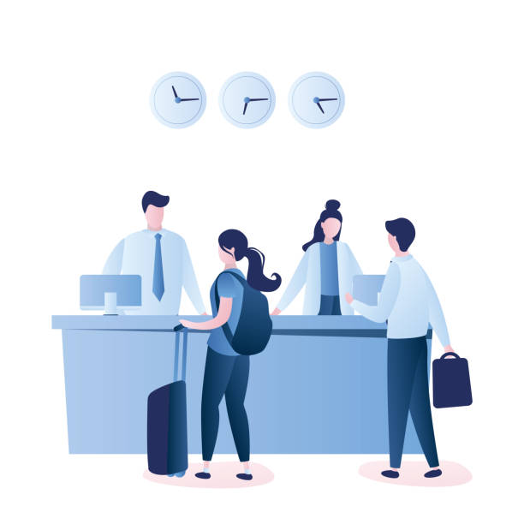
RESERVATION MANAGEMENT
The administrator, receptionist and the customer
are the main affected users by this function
Customer :
Customers can make reservations
Customer can update their reservation
Customer can view their reservation
Customer can cancel their reservation
10

Slide 11
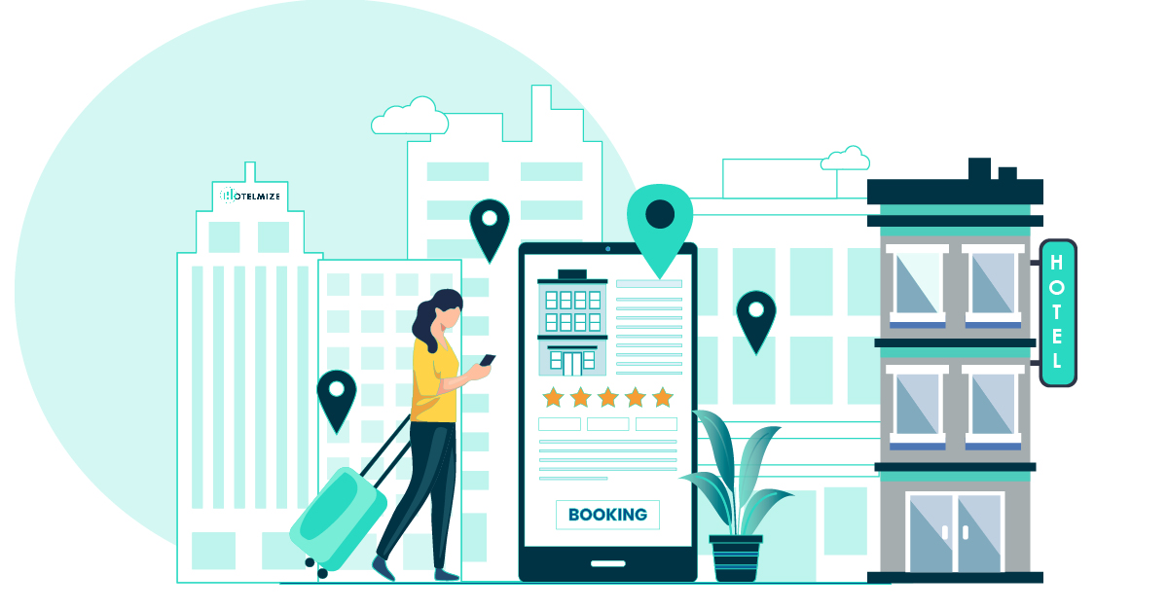
Administrator :
Manage Room reservations
View reservations list
Update room details and the prices
Add new room to the system
Check room availability
Add new room packages
Update existing room packages
Remove existing room packages
Generate Reports
Generate daily reservation report
Generate monthly report regarding the best booking rooms according to the total reservation count
11

Slide 12

IT20664862
Weerasinghe M.L.L.
RESTUARANT
MANAGEMENT

Slide 13

Restaurant management
Reserve tables (Online booking)
Select table capacity
Select/edit food menus
Delete reservations
Create menus
Create new menus
Edit menus
Delete menus

Slide 14
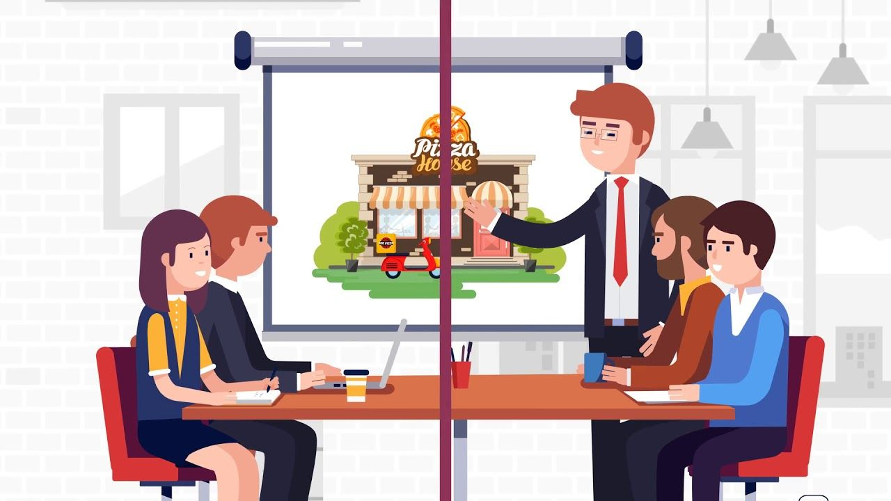
Keep records
Enter restaurant details including Profit, sales, allocation foods, wastage
Edit restaurant details
Delete restaurant details
Generate monthly report
Generate monthly report of the restaurant
Edit report
Delete report

Slide 15

IT20639976
Hansika A.G.D.R.
EMPLOYEE
MANAGEMENT

Slide 16
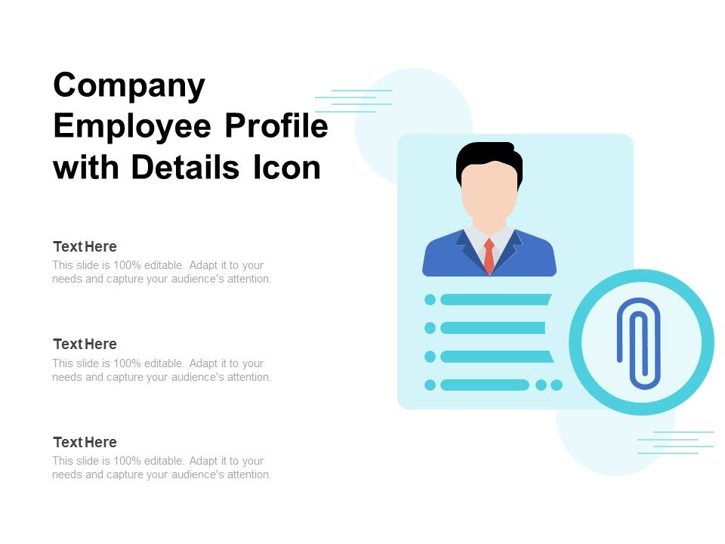
Employee Management
Employee management function manages following areas
handled by admin, HR and managers.
Manage Employees
Add, update, view and delete employee details
Maintain an employee profile
Employee Details Page
Employee can view, update their details
Generate Employee Reports

Slide 17
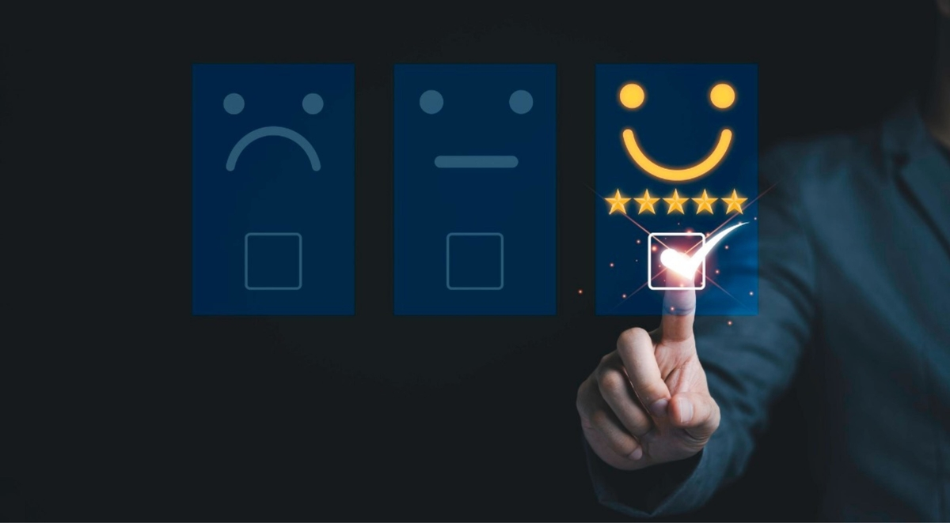
IT20640002
Bandara R.M.P.C.
FEEDBACK
MANAGEMENT

Slide 18
Feedback Management
Customer
Administrator
Place feedback
View feedback
View feedback
Reply to the feedback
Generate feedback report
Update feedback
Delete feedback
Analyze feedback report
Awareness of relevant parties regarding feedback
The feedback management function mainly involves the admin and the customer

Slide 19

Feedback management
Feedback management function handle the following scenarios
by customer and admin
Customer can place feedback, view feedbacks, update his feedback and delete his feedback.
Admin can view feedbacks, reply for the feedback and generate monthly feedback report.
The admin analyze the feedback report and notify the relevant parties.

Slide 20

IT20656874
Sithmini L.W.E.
FINANCIAL
MANAGEMENT

Slide 21



FINANCIAL MANAGEMENT
Handled by financial manager
Financial management function manages following areas
Manage Basic salaries (According to the employee type)
Manage Income and expenditure records
Calculate profit/ loss
Profit planning and control
Generate financial reports
21

Slide 22
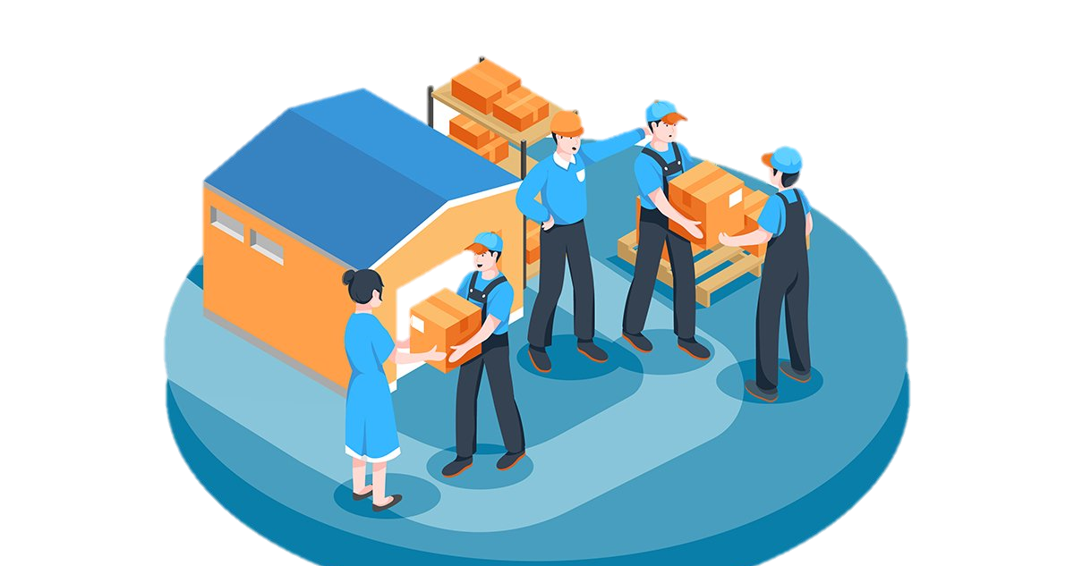
IT20661410
Perera M.L.D.
SUPPLIER
MANAGEMENT

Slide 23

SUPPLIER MANAGEMENT
Suppliers can create their accounts using suppliers' forms
After the accounts creation, they can start their supply businesses
Through this function
Suppliers can create, view, update and delete their details
Admin
manage suppliers' information
get suppliers' business types and manage them through the form
view, update and delete suppliers' accounts
manage suppliers' payments
Regulate orders
use the search bar to look up all the information about the suppliers
generate reports about orders, suppliers, and their payments

Slide 24
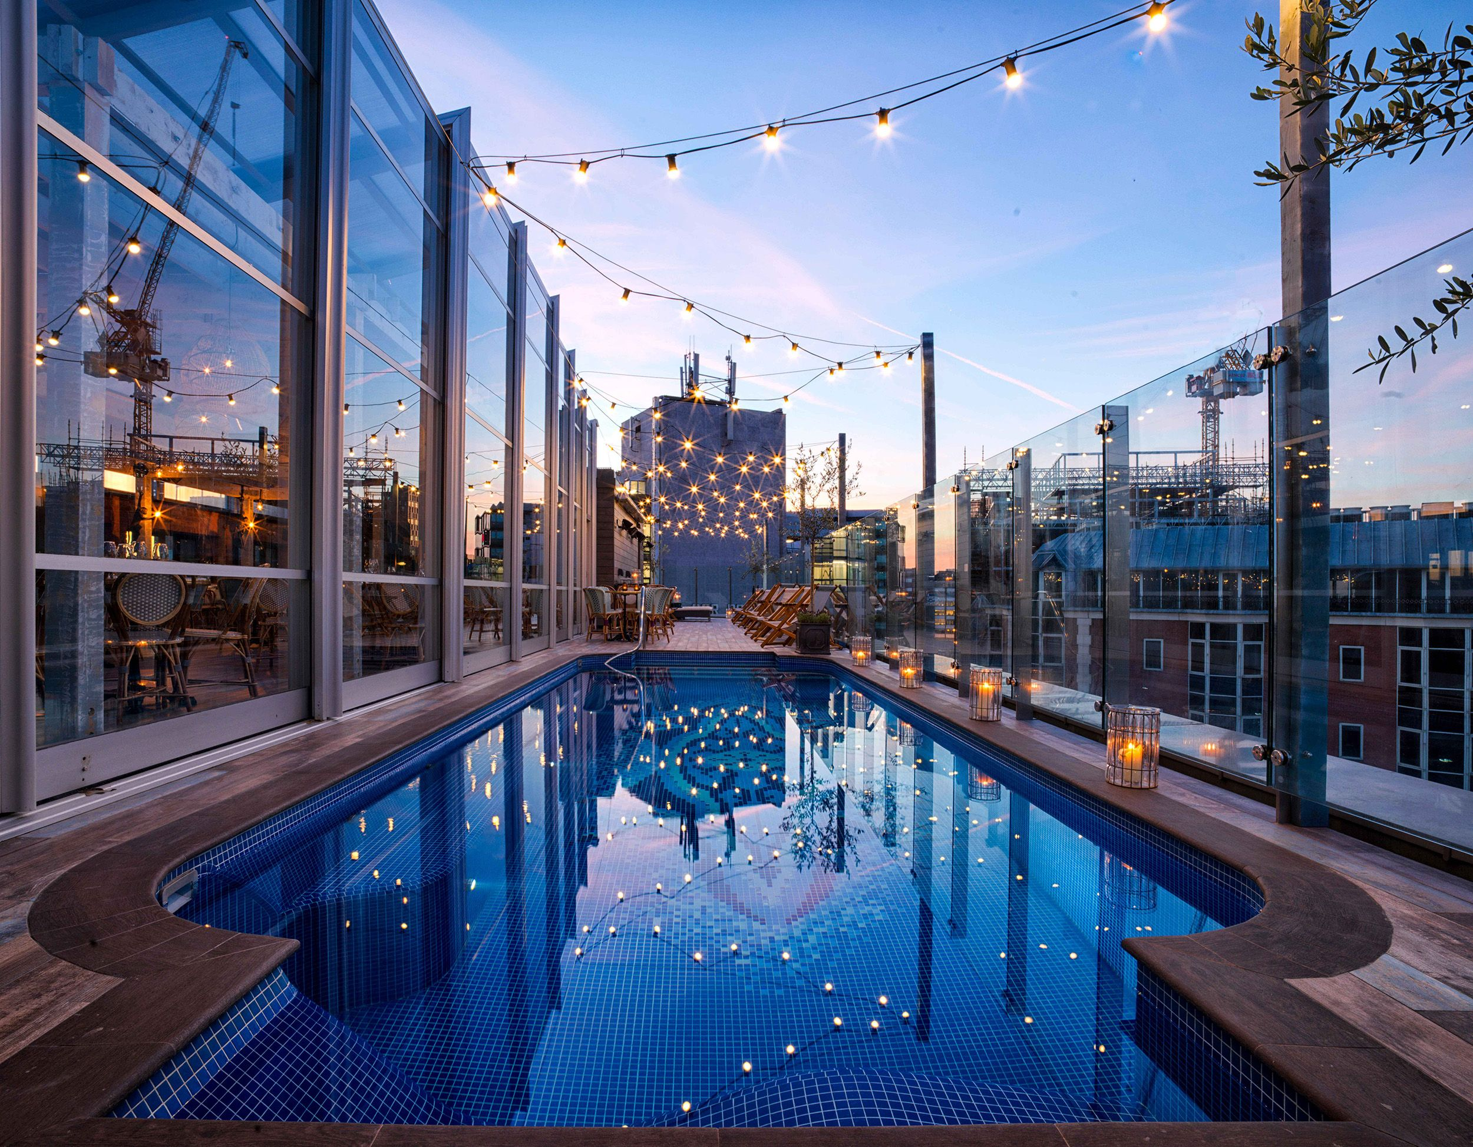
IT20641474
Pulasinghe T.K.
EXTRA-FACILITY
MANAGEMENT

Slide 25
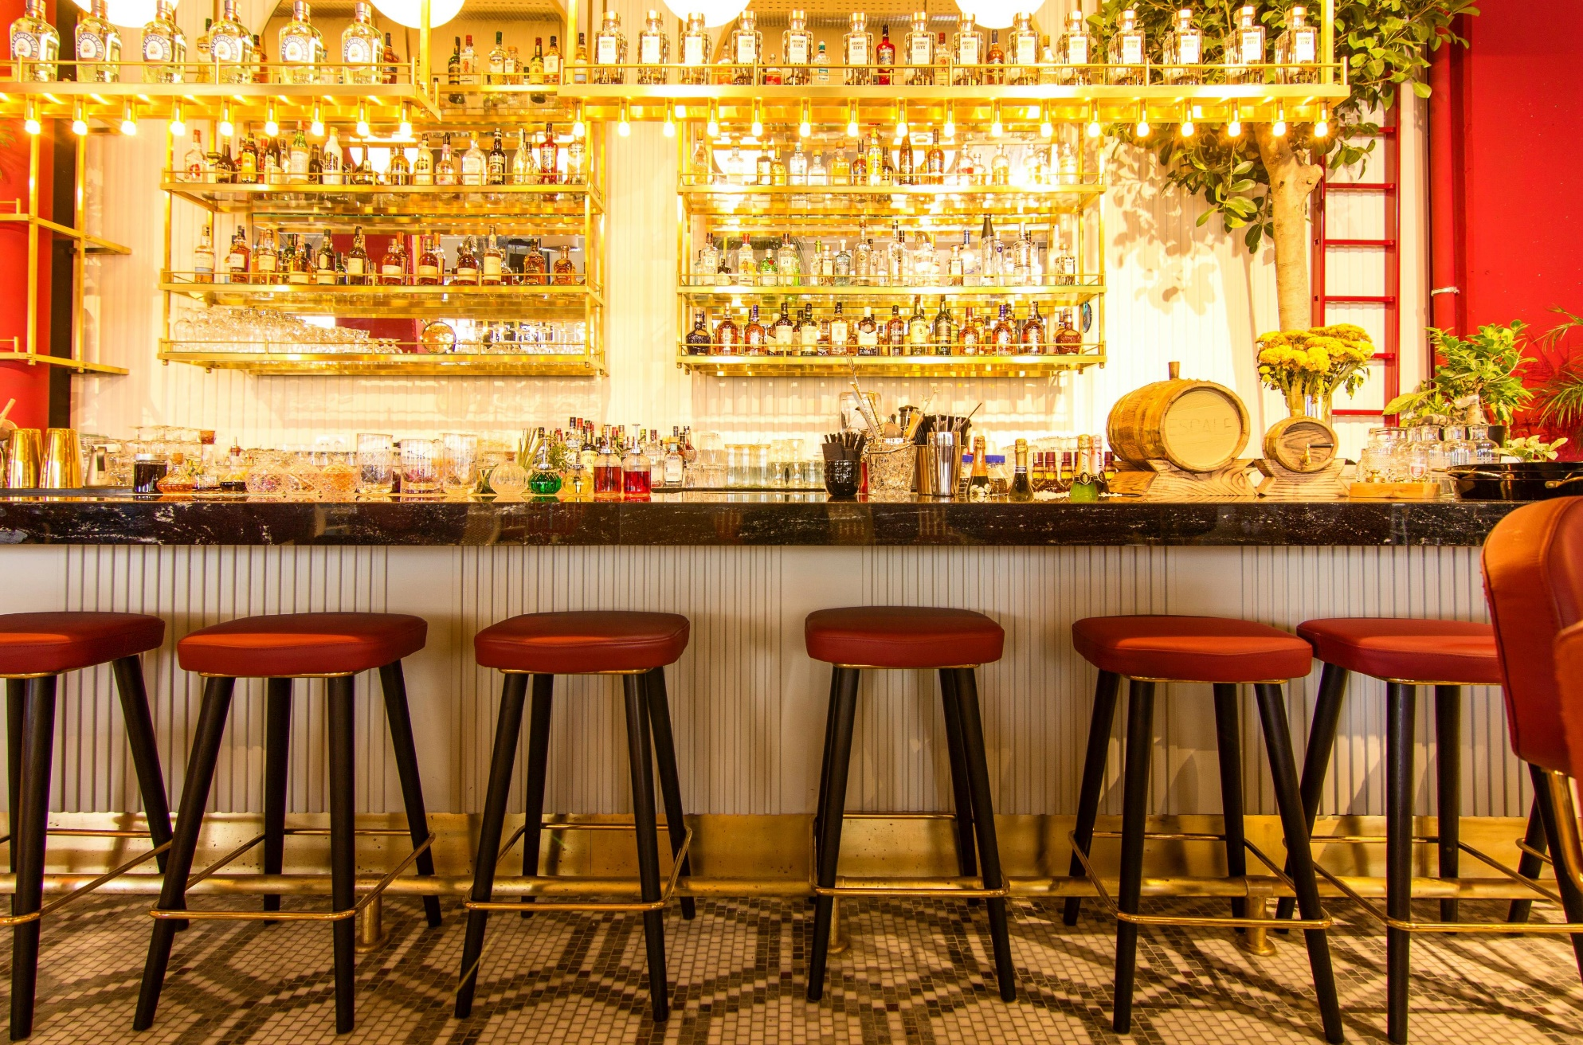
EXTRA-FACILITY MANAGEMENT
Extra facility management function handle following areas
Both registered and unregistered members can view the extra facility page
For a reservation, customer must be register in to the system
Extra – facility Reservation page
Display all the extra-facilities in hotel such as spa, mini bar, pool and club
Display all the packages according to the facilities
Customer can reserve any of above facilities
Customer can update their reservation
Customer can view their reservation
Customer can cancel their reservation if he/she wants

Slide 26

Extra-facility handling page
Admin can add new packages
Admin can update existing packages
Admin can delete existing packages
Generate a report regarding best booking facilities according to the customer reservations
Generate a monthly report including the summery of selected packages and the prices

Slide 27

IT20172046
Kumari K.T.C.R.
CUSTOMER
MANAGEMENT

Slide 28

CUSTOMER MANAGEMENT
Customers can register to the system after filling in their name, email, contact number, and address in the signup form.
registered customers can log in to the system using their login credentials.
Only the registered customers are allowed to make reservations.

Slide 29

Through this function
Customers can create, view, update and delete their profiles.
Admin
manage the customers’ profiles.
view and update the customers’ details.
remove inactive customers.
use the search bar to look up information about registered customers.
generate monthly reports about all the registered customers.
handling customer complaints and queries.
Assigning hotel guiders to the customers.

Slide 30


TOOLS AND TECHNOLOGIES
In this project we are using the MERN stack to develop the web application.
React is a JavaScript library that we use to develop the front end of the web application.
Visual studio code is the IDE we use to develop the web application.

Slide 31



TOOLS AND TECHNOLOGIES
Node JS is the main language that we use to develop the sever environment
MongoDB is the database program use for this web application
Express is the framework that we use to develop the back end of the web application

Slide 32

WORK DISTRIBUTION
Name | IT Number | Distribution
Thisaranga B.V.Y.L. | IT20640170 | User interface development Creating the database Back-end development Implementing the related create, update, retrieve and delete functions. Generating the report
Pulasinghe T.K . | IT20641474 | User interface development Creating the database Back-end development Implementing the related create, update, retrieve and delete functions. Generating the report

Slide 33
WORK DISTRIBUTION
Name | IT Number | Distribution
Bandara R.M.P.C. | IT20640002 | User interface development Creating the database Back-end development Implementing the related create, update, retrieve and delete functions. Generating the report
Sithmini L.W.E. | IT20656874 | User interface development Creating the database Back-end development Implementing the related create, update, retrieve and delete functions. Generating the report

Slide 34
WORK DISTRIBUTION
Name | IT Number | Distribution
Weerasinghe M.L.L. | IT20664862 | User interface development Creating the database Back-end development Implementing the related create, update, retrieve and delete functions. Generating the report
Perera M.L.D. | IT20661410 | User interface development Creating the database Back-end development Implementing the related create, update, retrieve and delete functions. Generating the report

Slide 35
WORK DISTRIBUTION
Name | IT Number | Distribution
Kumari K.T.C.R. | IT20172046 | User interface development Creating the database Back-end development Implementing the related create, update, retrieve and delete functions. Generating the report
Hansika A.G.D.R. | IT20639976 | User interface development Creating the database Back-end development Implementing the related create, update, retrieve and delete functions. Generating the report

Slide 36
PROJECT MANAGEMENT PLAN
22/01/15 22/02/06 22/02/28 22/03/20 22/04/09 22/04/29 22/05/20

Slide 37

Thank You !

